Slide 1

Cultural Data Science
Final Project
Reviewing reviews – an NLP Analysis of Restaurant Customer Reviews from Silkeborg Based Venues

Slide 2
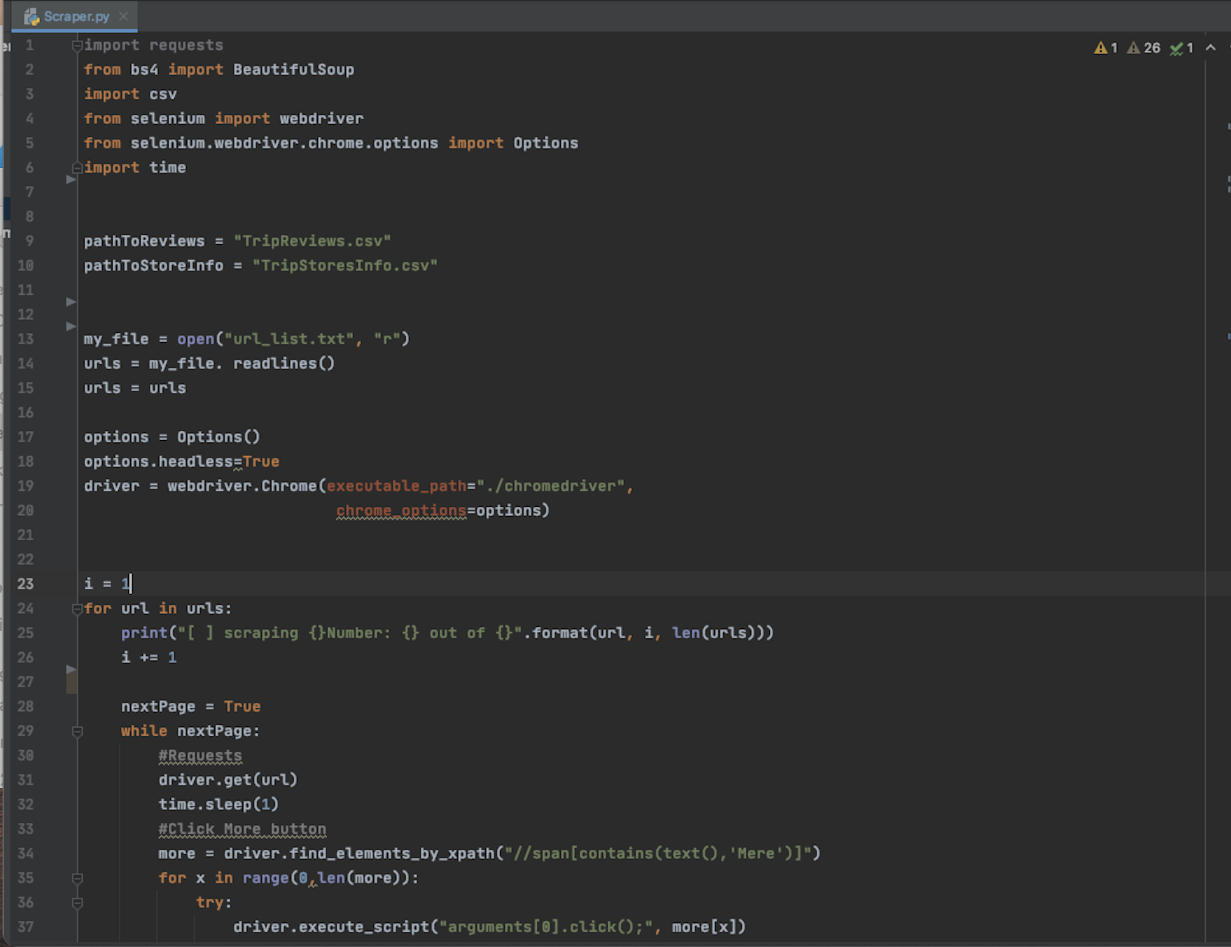
Scraping Data
Restaurant reviews from Silkeborg

Slide 3
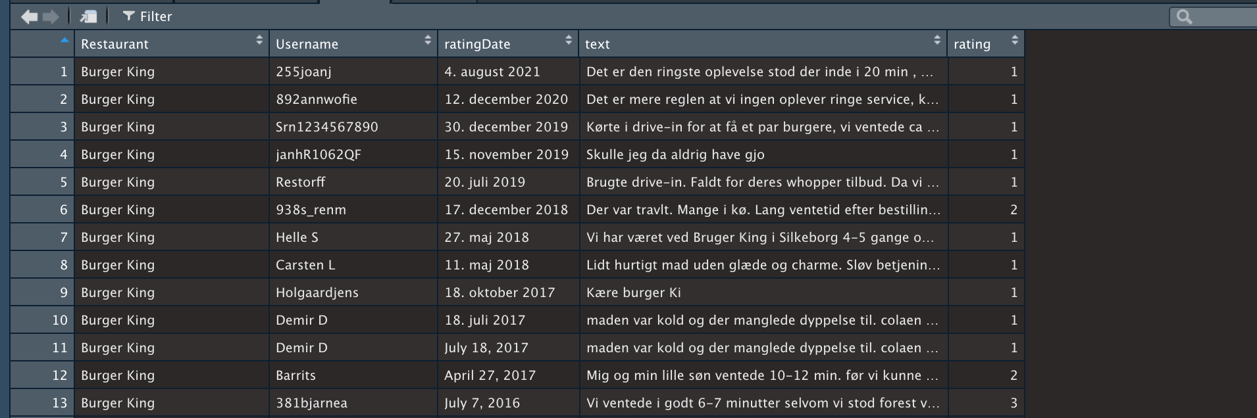
Data
Information is nested in different variables
The text variable and the rating variable are of the most interest

Slide 4
Analysis
Topic Modelling (Seeded LDA)
-Service/staff: (”betjening”, ”tjener”, ”personale”, ”behandling”, … )
-Quality of food/meal: (”kok”, ”gastronomi”, ”mad”, ”niveau”, … )
-Atmosphere (”…”, ”…”, ….)
-Location/View (”…”, ”…”, ….)
-Price (”…”, ”…”, ….)
Which topics are constituting good reviews vs. bad reviews?
At restaurant level
At geographical level
Cultural relevance
For owners of restaurants
For restaurant goers in general

